Slide 1

Improving the Perception of Fairness in Shapley-Based Allocations
Meir Nizri, Noam Hazon, Amos Azaria
Department of Computer Science,
Ariel University, Israel
Notes:
Hello everyone, My name is Meir. In this presentation I'm going to introduce you with a new method to generate explanations for the Shapley value. But first, we need to first explain what is a coalitional game and what is the Shapley-value.

Slide 2
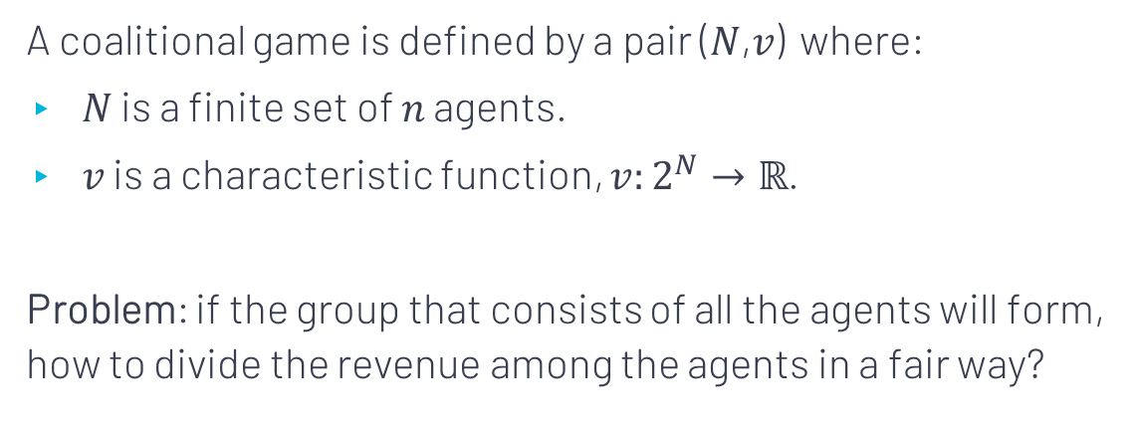
Coalitional Games
A coalitional game is defined by a pair (𝑁,𝑣) where:
𝑁 is a finite set of 𝑛 agents.
𝑣 is a characteristic function, $v:2^{N}→ℝ$.
Problem: if the group that consists of all the agents will form, how to divide the revenue among the agents in a fair way?

Slide 3











Glove Game
A
$$=\$0$$
+
$$=\$12$$
B
$$=\$0$$
+
$$=\$12$$
C
$$=\$0$$
+
$$=\$0$$
+
+
$$=\$12$$
Problem: how to divide the $12 revenue among the 3 agents in a fair way?
Notes:
Basically, a coalitional game is a function that associates every subset of agents with a value that represents their collective payoff if they will cooperate. The problem is if the group that consists of all the agents, also known as the grand coalition, will form, how to divide the revenue among the agents in a fair way? These games represent many real-world problems.
For example, here we see a coalitional game with 3 agents: A, B, and C. This game is also known as the “glove game”. Agent A has only a left-glove and agents B and C have only a right-glove. A pair of left and right gloves is worth $12 but a single glove is worth nothing. In case the three agents collaborate, how should they divide the $12 revenue between them?

Slide 4
Shapley Value (1953)
The allocation for every agent is her average marginal contribution to the payoff of any subset of other agents.
Axioms: Efficiency, Symmetry, Null player, Additivity
“ The Shapley value is the most important normative division scheme in cooperative game theory ” (E. Winter 2002).
Notes:
The Shapley value is a solution to the problem of coalitional games. According to the Shapley value, the allocation for every agent is her average marginal contribution to the payoff of any subset of other agents. The Shapley value is the only payoff allocation that satisfies the following four desirable axioms: efficiency, symmetry, null player property and additivity. It has been termed the most important normative division scheme in cooperative game theory. However, humans not always observe it as fair.

Slide 5
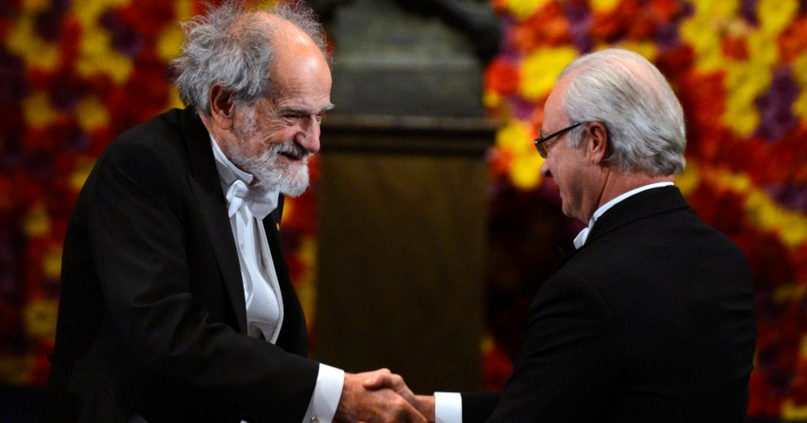
The Shapley value has been termed the most important normative division scheme in cooperative game theory (E. Winter 2002).
Nobel Prize awarding ceremony, 2012
Notes:
עוד מעט נראה דוגמה רק נגיד שהפתרון הזה הוא מרכזי ואפילו קיבל עליו פרס נובל.

Slide 6










Back to Glove Game:
A
$$=\$0$$
+
$$=\$12$$
B
$$=\$0$$
+
$$=\$12$$
C
$$=\$0$$
+
$$=\$0$$
+
+
$$=\$12$$
Shapley value Allocation
A
$$8$
B
$$\$2$$
C
$$\$2$$
Notes:
Following the previous example, if all agents collaborate, the Shapley value allocates $8 to agent A and only $2 to B and $2 to C. Now, it may seem fair that agent A gets more than the other agents since he has a more unique item, but most of the people we presented with this problem said such an allocation is unfair.

Slide 7

Game decoposition
Coalitional game
We developed an automatic method that generates intuitive customized explanations for the Shapley-value in any coalitional game.
Every game is decomposed into sequence of sub-games that their Shapley allocation is easier to perceive as fair.
ETX game
ETX game
ETX game
ETX game
Notes:
To make the Shapley value more fair to humans we have developed an algorithm that for every coalitional game automatically generates intuitive explanations that are customized for this specific game.
In short, our algorithm decomposes any coalitional game into a sequence of sub-games that their Shapley allocation is easier to perceive as fair. We call these sub-games ETX games.

Slide 8
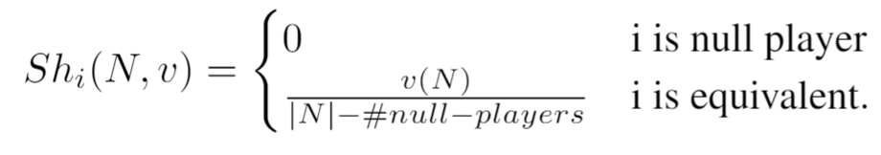
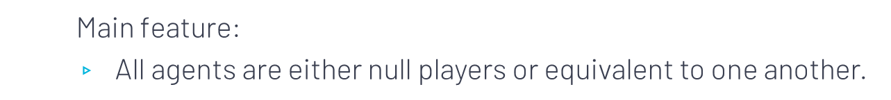
ETX Games
Main feature:
$\text{All} \text{agents} \text{are} \text{either} \text{null} \text{players} \text{or} \text{equivalent} \text{to} \text{one} \text{another}\text{.}$
Notes:
In every ETX game, all the agents are either contribute nothing or make an equal contribution to the other agents. Each agent who contributes nothing should receive a payoff of $0, and all other agents should equally share the revenue between them.
The explanation is basically showing the user how the sum of all ETX games equals the original game, and how the sum of all the intuitive allocations is equal to the Shapley value on the original game.

Slide 9
Simulation - Glove Game
ETX sub-games
Glove Game
A=$0
B=$0
C=$0
A+B=$12
A+C=$12
B+C=$0
A+B+C=$12
(1)
A=$0
B=$0
C=$0
A+B=$12
A+C=$0
B+C=$0
A+B+C=$12
(2)
A=$0
B=$0
C=$0
A+B=$0
A+C=$12
B+C=$0
A+B+C=$12
(3)
A=$0
B=$0
C=$0
A+B=$0
A+C=$0
B+C=$0
A+B+C=$-12
Allocations
A: $8
B: $2
C: $2
A: $6
B: $6
C: $0
A: $6
B: $0
C: $6
A: $-4
B: $-4
C: $-4
Notes:
For example, the glove game can be decomposed into three ETX sub-games. As you can see, the sum of all the sub-games is equal to the glove game and the sum of all their intuitive allocations is indeed equal to the Shapley value.

Slide 10
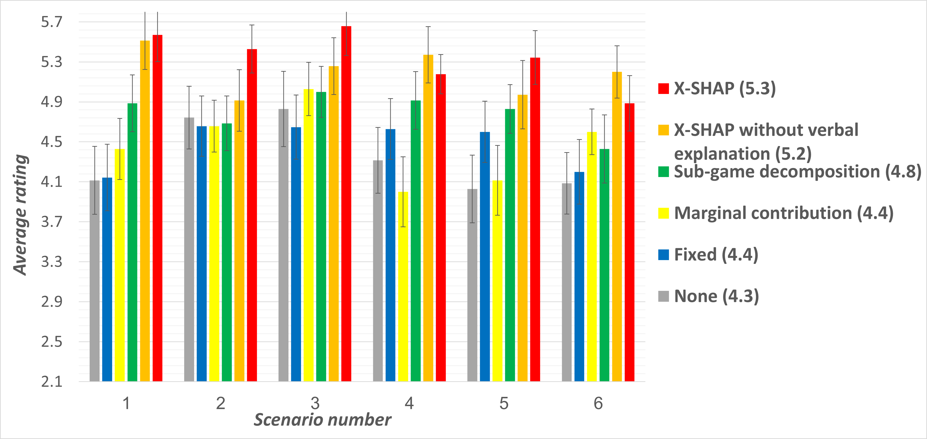
Survey results
Notes:
In order to evaluate our explanation, we conducted a survey with human participants. The survey examined six coalitional games, representing a variety of scenarios. Each participant was presented with two different scenarios along with their Shapley value and one of six types of explanations: our explanation or other benchmark explanation. The participants were asked to rate how fair the proposed allocation.
The results shows that our explanations achieved significantly higher fairness rating compared to other explanations in all the games examined.

Slide 11
THANKS!
You can find me at:
meir.nizri@msmail.ariel.ac.il
Notes:
And that's it. Thanks for listening.

Slide 12
Conclusions
First automatic method that generates customized explanations for the Shapley value in any coalitional game.
Utilizing known axioms and show that they can be used for increasing the rating of fairness of the Shapley allocation.
We show that when applying our method, humans perceive Shapley-based payoff allocation as significantly more fair than when using other methods.

Slide 13
Future Work
Games with many agents:
Present for a user only the sub-games in which she receives a non-zero payoff.
Interactive process

